Slide 1
The kickin‘ chickens

Slide 2

Strategy
Combine different datasets retrieved by API (Google Maps, Traffic Control Cameras) with public transport, commuter data, cost data and garbage disposal data from the Federal Office of Statistics
In order to find the places with the most traffic congestion the mapping and combining of said data supports efficient planning and decision making, whilst making it possible to compare the statistics with other cities in the Kanton
Based on this data the population can decide on measures (e.g. Vertical Gardens, Traffic Flow Optimization) to reduce traffic jams and increase efficient flow through the city

Slide 3
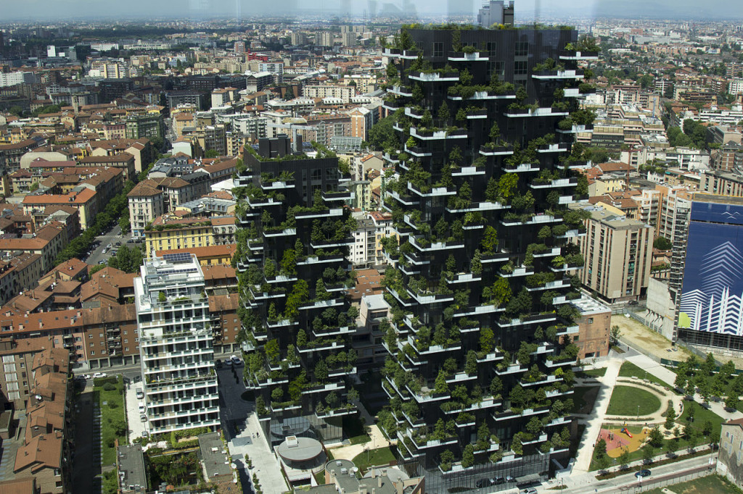
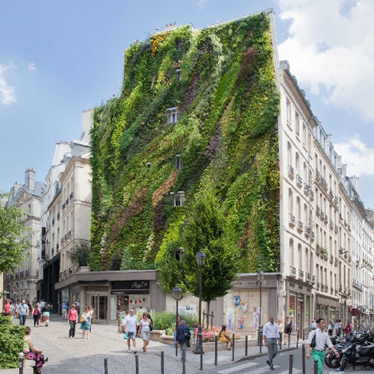
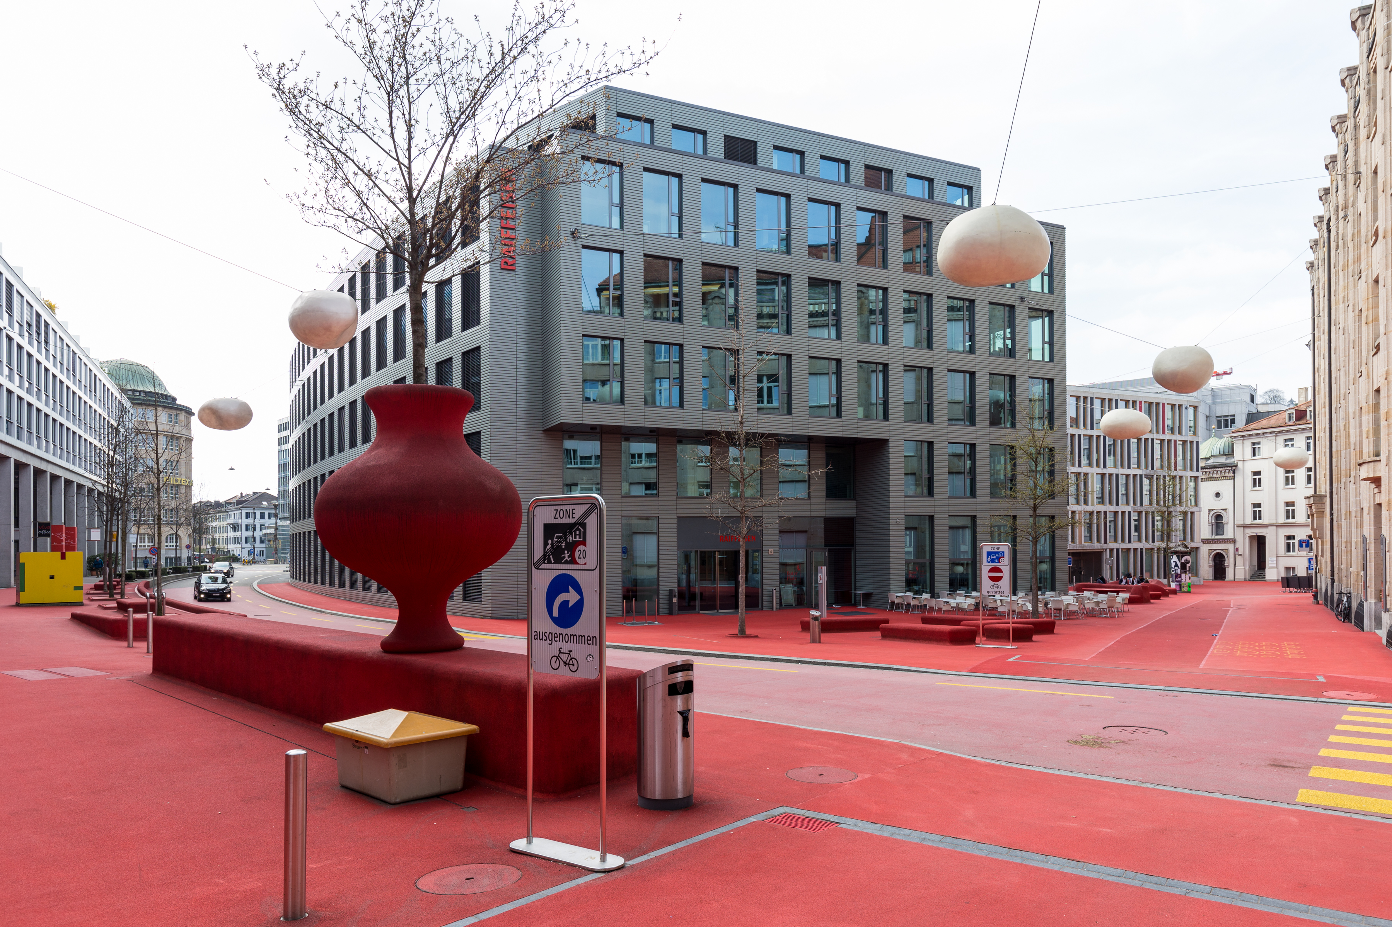
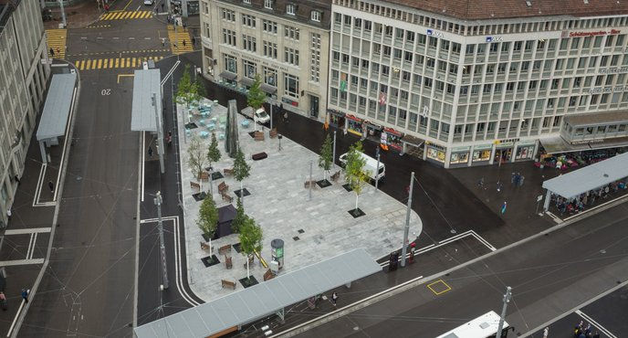
Vote Case 1 – Green Sankt Gallen
Projects in SG
Goals
Raiffeisen
Train station square
Reduce air pollution in the city
Reduce health costs and citizen wellbeing

Slide 4
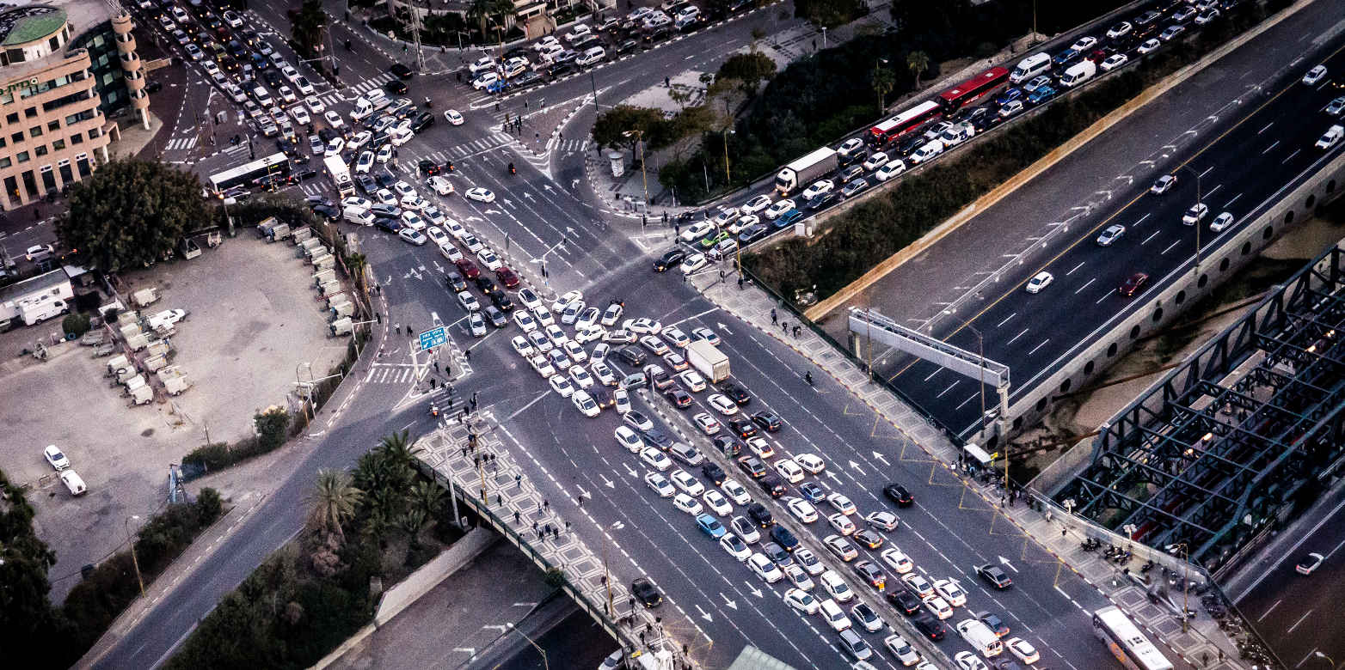
Vote Case 2 – Traffic Optimization Gallen
Projects in SG
Goal
Garbage truck routes
Bus routes
Congestion/jams
First implemented case of strategic traffic routing for garbage disposal in Europe
Safe time, money and the power

Slide 5
Arguments based on Data
Research Vote 1
Research Vote 2
Traffic jams cause more pollution
Traffic jams cause time inefficiencies for the working class
Cost to the city: additional salary, vehicle usage and income tax
Higher around traffic congestion, train stations and building sites
Plants reduce the small particals and pollution in the air

Slide 6
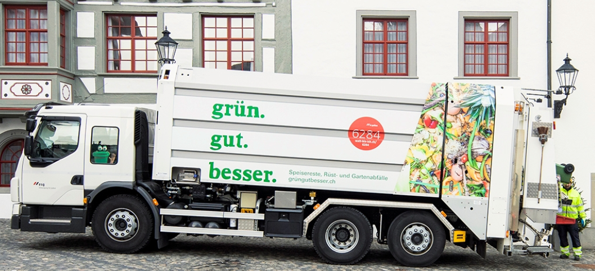

Vote Case 3 – Pollution/Garbage
Statistics
Goals
Platic use in the city center
Data about Recycling costs of materials
Sustainable packaging
Vote for long-term environmental efficiency

Slide 7
Conclusion
Furthermore, by combining different datasets retrieved by API from the City of SG and additional sources the following cost oriented topics can be addressed as well:
Infrastructure
Telecommunication (Free WIFI, 5G) and general Environmental Considerations
Tourism
Gastronomy
Plastic-less city centre (no plastic straw policy)
Sports & Culture
New public sport areas, Education system reform, Teacher & Healthcare worker measures
Work
Shared workspaces for government employees, funding of new ventures

